Slide 1
Itemized Inventory

Slide 2
Agenda
Itemized Inventory - Prep
Itemized Inventory – 3rd Party
Itemized Inventory – Generating & Processing
Itemized Inventory - Reports
Category Level Inventory
Itemized Inventory – CStoreOffice Mobile

Slide 3
Itemized Inventory Prep

Slide 4
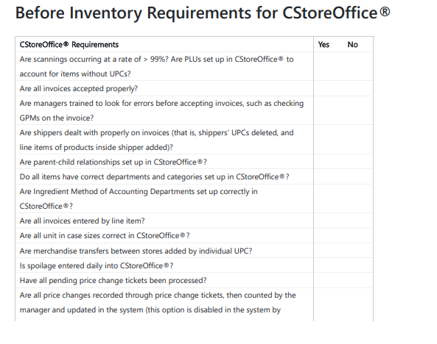
Itemized Inventory Prep
The Item Level Inventory Preparation Checklist is designed as a preparation guide for item level inventory.
It is broken down into the following sections:
Before Inventory Requirements for CStoreOffice®
Best Practices for Operational Set Up
During Inventory
After Inventory
Researching Inventory

Slide 5
Itemized Inventory 3rd Party

Slide 6
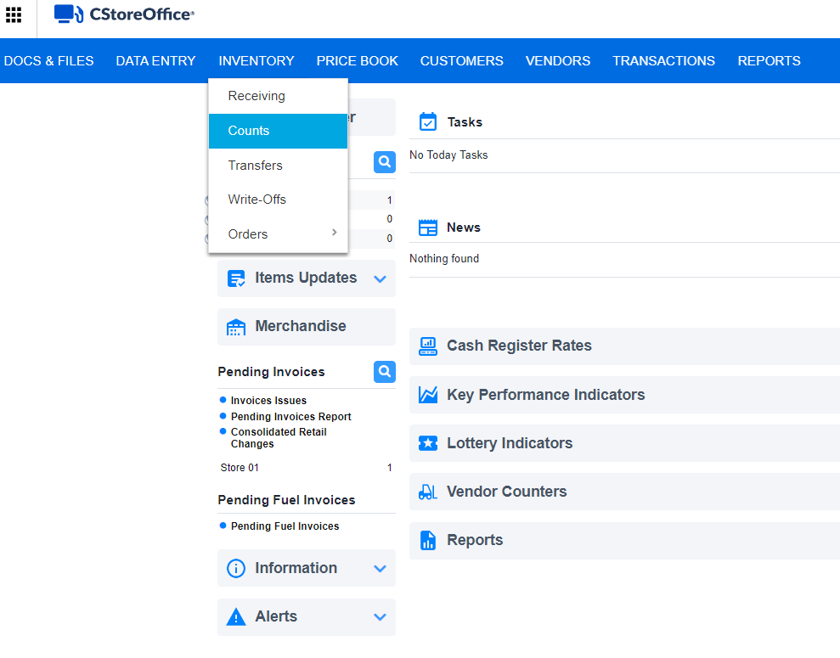
Itemized Inventory – 3rd Party
You can conduct physical inventory using a 3rd party service and then upload this data to CStoreOffice®.
To conduct a physical inventory using a 3rd party service:
In CStoreOffice®, go to
Inventory
Counts

Slide 7
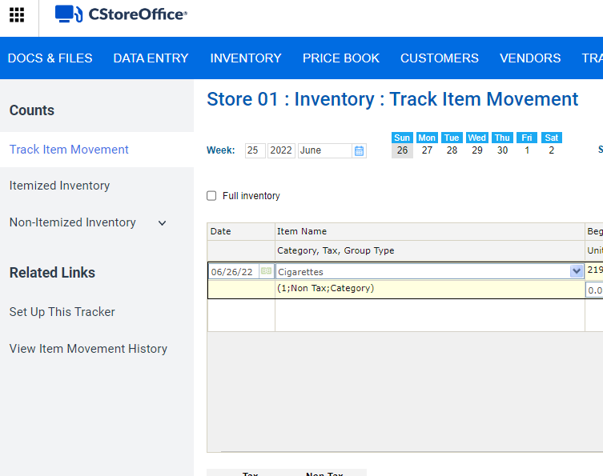
Itemized Inventory – 3rd Party
In the left menu, select:
Itemized Inventory

Slide 8
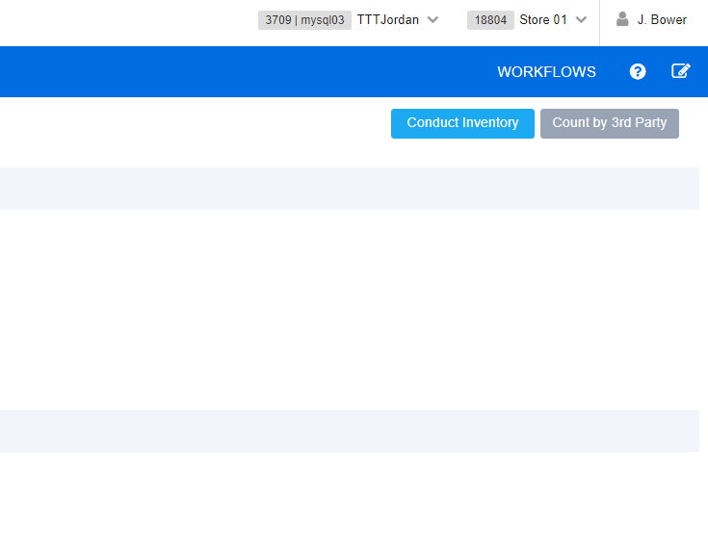
Itemized Inventory – 3rd Party
At the top right of the form, click:
Count by 3rd Party

Slide 9
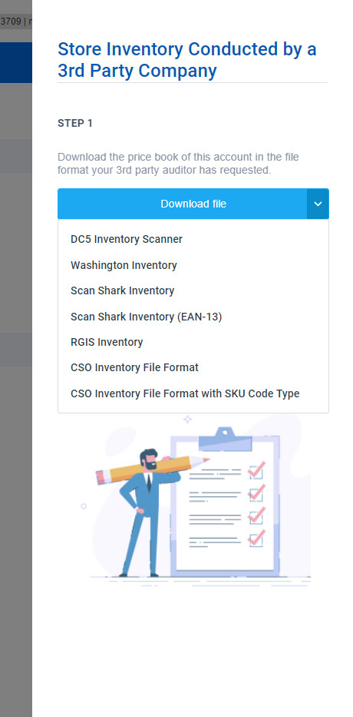
Itemized Inventory – 3rd Party
In the right pane, select
Download file
and then select the necessary HHD model.
DC5 Inventory Scanner
Washington Inventory
Scan Shark Inventory
Scan Shark Inventory (EAN-13)
RGIS Inventory
CSO Inventory File Format
CSO Inventory File Format with SKU Code Type

Slide 10
Itemized Inventory – 3rd Party
Petrosoft recommends the CSO Inventory File Format
Once the file has downloaded, send it to the 3rd party inventory company so it can be downloaded to their devices.

Slide 11
Itemized Inventory – 3rd Party
Do a shift change at the cash register right before the inventory starts.
Have the 3rd party company conduct their item counts via their devices.
Once the inventory is complete, conduct a shift change again.
Have the 3rd party company download the file from their devices.

Slide 12
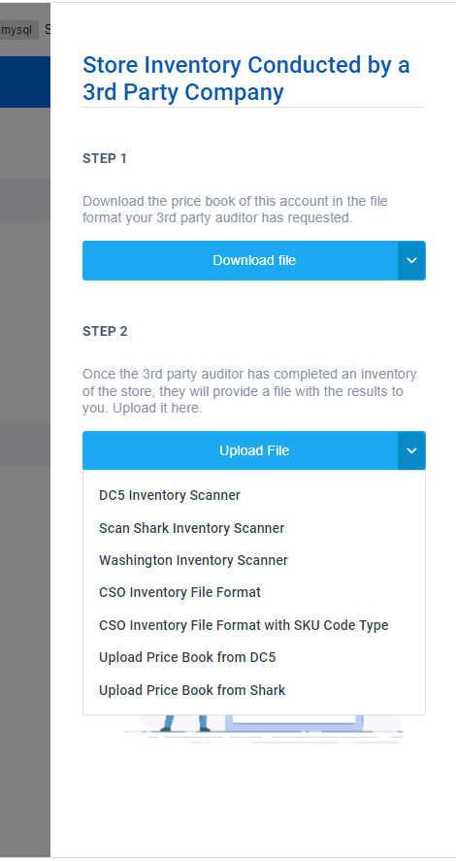
Itemized Inventory – 3rd Party
In CStoreOffice®, navigate back to Inventory > Counts.
In the left menu, select Itemized Inventory.
At the top right of the form, click Count by 3rd Party.
In the right pane, click Upload file and select the necessary HHD model.

Slide 13
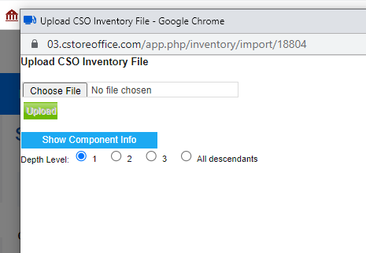
Itemized Inventory – 3rd Party
Select Choose File, and browse to the location of the file

Slide 14
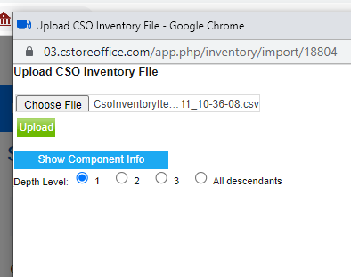
Itemized Inventory – 3rd Party
Click Upload file

Slide 15
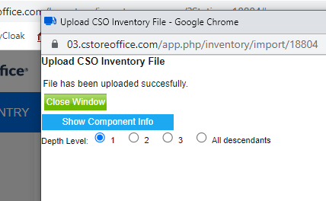
Itemized Inventory – 3rd Party
Wait for the message:
File has been uploaded successfully

Slide 16
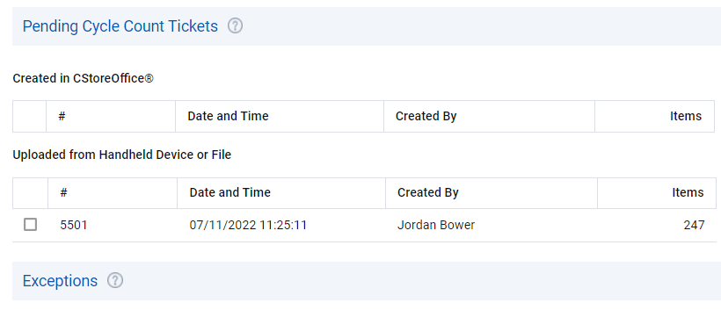
Itemized Inventory – 3rd Party
Result:
The processed file is displayed in the
Uploaded from Handheld Device or File section.
Select the necessary inventory file.

Slide 17
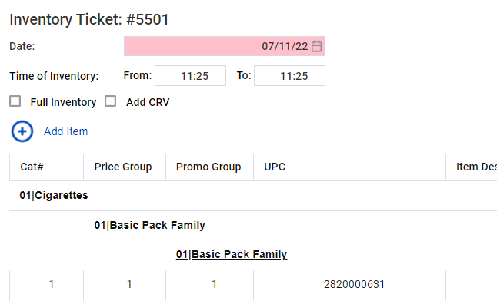
Itemized Inventory – 3rd Party
At the top left of the form, select the correct shift date.
Next, select or clear the Full Inventory check box to identify the inventory as full or partial.
Optional: Select to Add CRV to calculated bottle deposits totals linked to their items.
Optional: You may add additional items to the cycle count by selecting Add Item

Slide 18
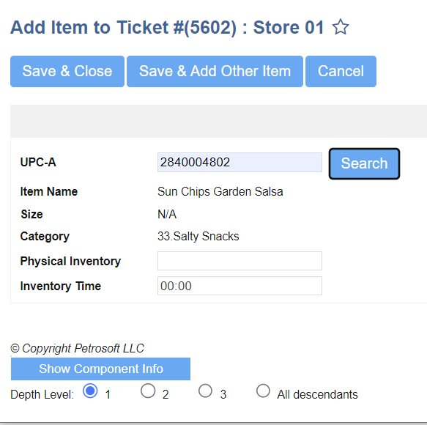
Itemized Inventory – 3rd Party
If Add Item is selected, you will be displayed the Add Item to Ticket window.
Enter in the item’s UPC. Select Search.
If item is located within your Pricebook, the Item Name, Size, and Category attributes will auto populate.
Select Save & Close or Save & Add other items if needed.

Slide 19
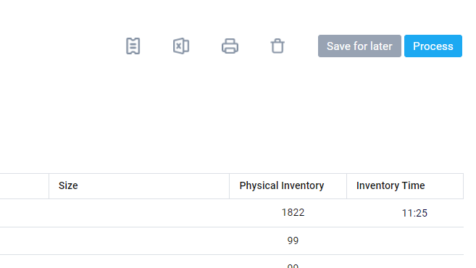
Itemized Inventory – 3rd Party
At the top right of the form, click Process.

Slide 20
Itemized Inventory Generating & Processing

Slide 21
Itemized Inventory – Generating & Processing
CStoreOffice® gives you an ability to work with two types of tickets:
Cycle count ticket:
This type of tickets is generated by the user's request and doesn't show the user how many items must be on hand at the time of the count.
Audit tickets:
This type of tickets is generated by the user's request and indicates the quantity of items that must be on hand at the time ticket is generated.
Depending on the ticket parameters, a cycle count ticket can be created using one of the following methods:
By Item Tags
By Vendor
Ingredient Method of Accounting

Slide 22
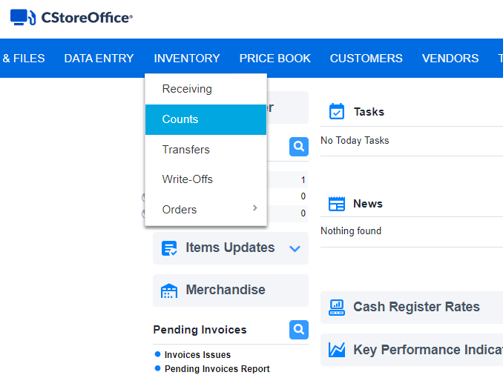
Itemized Inventory – Generating & Processing
To generate a cycle count ticket:
From the main page of CStoreOffice®
Inventory
Counts.

Slide 23
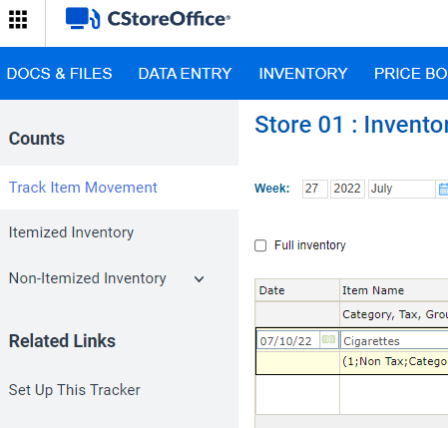
Itemized Inventory – Generating & Processing
In the left menu, select Itemized Inventory

Slide 24
Itemized Inventory – Generating & Processing
At the top right of the Itemized Inventory form,
Select Conduct Inventory

Slide 25
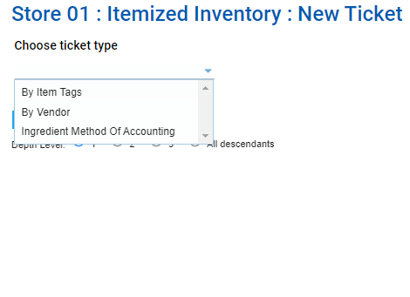
Itemized Inventory – Generating & Processing
From the Choose ticket type dropdown list, select the method to be used for the ticket:
By Item Tags: Select this method if you want to conduct inventory by item tags. In the Found Items list, select check boxes next to the necessary item tags.
By Vendor: Select this method if you want to conduct inventory by vendors. From the Choose Vendor list to the right, select the necessary vendor.
Ingredient Method of Accounting: Select this method if you want to conduct inventory for items included in categories and departments that were set up with the ingredient method of accounting option. In the Found Items list, select check boxes next to the necessary categories.

Slide 26
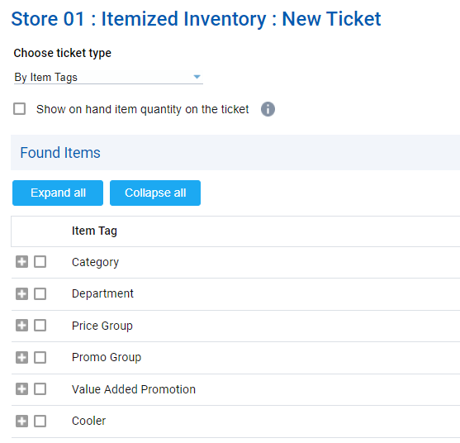
Itemized Inventory – Generating & Processing
Select the Show on hand item quantity on the ticket check box to generate an audit ticket. In this case, the item quantity will be displayed in the ticket.
Select fields to generate the cycle count by from the bottom of the page under Item Tag

Slide 27
Itemized Inventory – Generating & Processing
At the top right of the form, click Generate

Slide 28
Itemized Inventory – Generating & Processing
At the top right, Print the generated cycle count ticket.

Slide 29
Itemized Inventory – Generating & Processing
Complete a shift change at the cash register right before the count begins.
Conduct the count and mark the item quantity on the paper ticket.
Once the count is complete, conduct a shift change again.
Counts are now ready to be entered into CStoreOffice®

Slide 30
Itemized Inventory – Generating & Processing
Return to the Itemized Inventory page.
From the main page of CStoreOffice®
Inventory
Counts.

Slide 31
Itemized Inventory – Generating & Processing
In the left menu, select Itemized Inventory

Slide 32
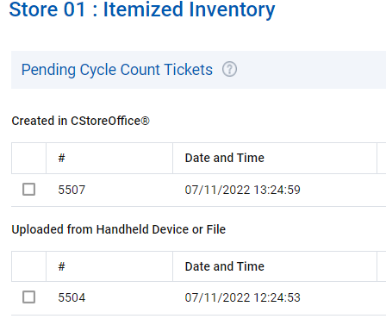
Itemized Inventory – Generating & Processing
On the Itemized Inventory page, select the necessary ticket, under the Created in CStoreOffice® area.

Slide 33
Itemized Inventory – Generating & Processing
At the top left of the form, specify the date and time of the cycle count in the Date and Time of Inventory fields.
Select or clear the Full Inventory check box to identify the inventory as full or partial.
Optional: Select to Add CRV to calculated bottle deposits totals linked to their items.
Optional: You may add additional items to the cycle count by selecting Add Item
In the Physical Inventory column, enter the item quantity from your printed paper ticket.

Slide 34
Itemized Inventory – Generating & Processing
Once complete, at the top right of the form, click Process.

Slide 35
Itemized Inventory CStoreOffice Mobile

Slide 36
Itemized Inventory CStoreOffice® Mobile

Slide 37
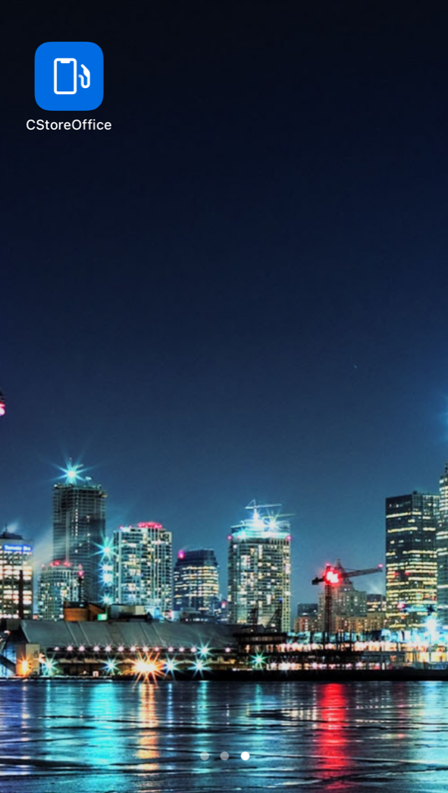
Itemized Inventory – CStoreOffice Mobile
With the CStoreOffice Mobile app, you can
perform itemized inventory with your mobile device.
You can create a cycle count ticket and add all desired items that need to be counted, either by scanning item barcodes or manually searching.
Once the items are counted and the cycle count ticket is ready, you can upload it to CStoreOffice®, and the store manager can then proceed with the ticket.

Slide 38
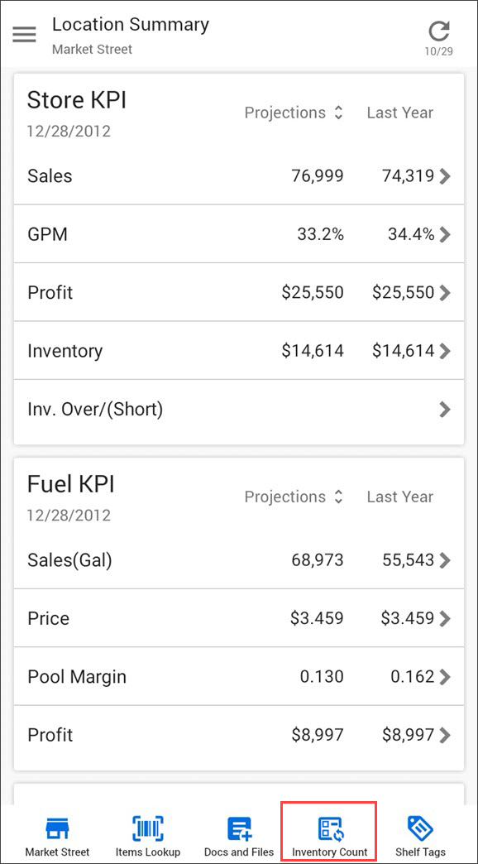
Itemized Inventory – CStoreOffice Mobile
To perform itemized inventory:
At the bottom of the Summary view, tap the location name and from the list, select the location for which you want to perform itemized inventory.
At the bottom of the Summary view, tap Inventory Count

Slide 39
Itemized Inventory – CStoreOffice Mobile
Add an item to the cycle count ticket. You can do it in the following ways:
Scan the item barcode: To the right of the search field, tap the barcode icon and point the device camera at the item barcode. CStoreOffice® Mobile App will automatically find the item in the Price Book by the scanned barcode and add the item to the cycle count ticket.
Find the item in the Price Book: In the search field, enter the item name or a part of it and tap the search icon to the right. You can also search for items by UPC. In the results list, tap the item you want to add.
Add the item from the item card: You can add an item to the cycle count ticket directly from the item card.

Slide 40
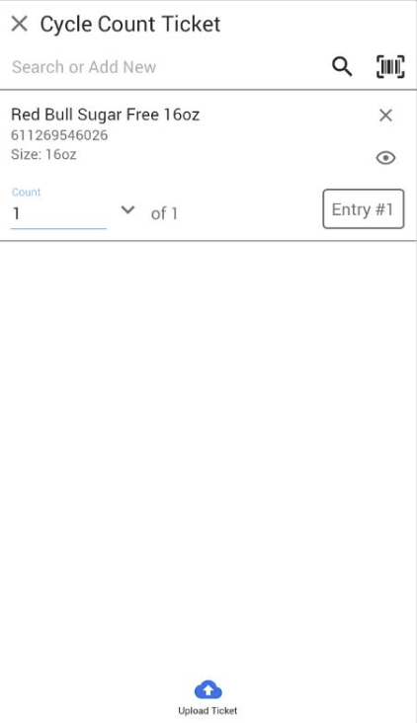
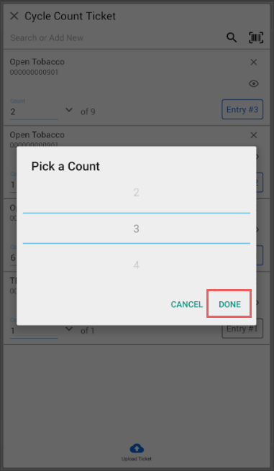
Itemized Inventory – CStoreOffice Mobile
In the Count field, specify the number of counted items.
You can type the number directly or tap the arrow icon to the right and scroll up or down in the Pick a Count window.

Slide 41
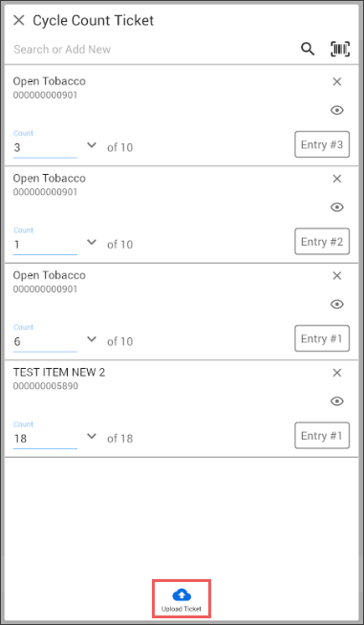
Itemized Inventory – CStoreOffice Mobile
Repeat this process for all items you want to add to the cycle count ticket
Once all desired items are scanned, and a physical count has been entered for each, at the bottom of the page, tap Upload Ticket.

Slide 42
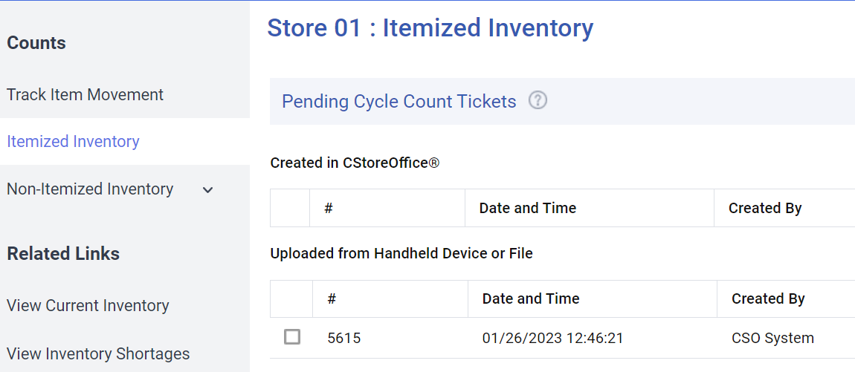
Itemized Inventory – CStoreOffice Mobile
Result:
The ticket is uploaded to CStoreOffice® and becomes available in the Itemized Inventory form, under Uploaded from Handheld device or File.

Slide 43
Itemized Inventory Reports

Slide 44
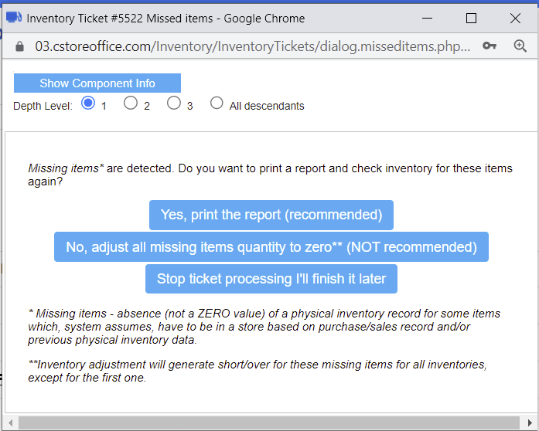
Itemized Inventory – Missed Item Report
Once you process you inventory ticket, If the Full Store inventory option is selected, you will receive a “Missed Items” message if CStoreOffice calculates possible missed items based on current on-hand counts.
You will be able to Print the Missed Item report to review.
CStoreOffice will revert to the pending ticket, to give you a chance to check the Missed Items report for accuracy. The pending ticket will be editable and must be Processed a second time to accept your counts.

Slide 45
Itemized Inventory – Missed Item Report
Accepting your counts will calculate your Short/Over report automatically.
This report will display itemized and non-itemized adjustments.

Slide 46
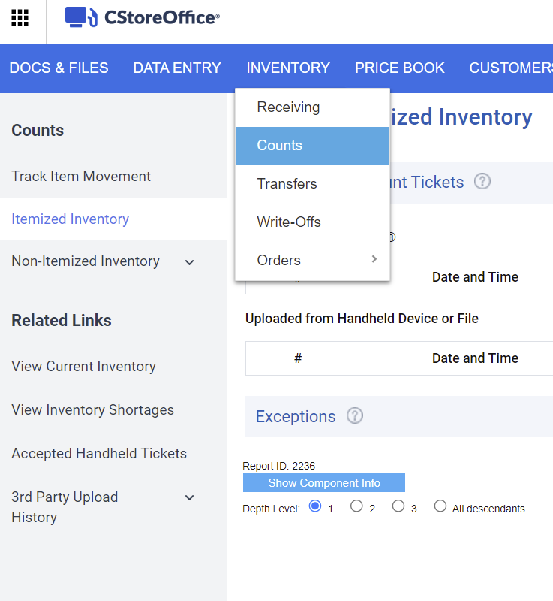
Itemized Inventory – Item Shortage Report
Once an inventory is processed, review your Item Shortage report for more in-depth information.
To open the Item Shortage report, do one of the following:
Inventory
> Counts
> Itemized Inventory
in the Related Links section, select View Inventory Shortages.
Alternatively, you can access the Item Shortage reports by navigating from the main page:
Reports
> Store
> Inventory
> Shortages
> Item Shortage

Slide 47
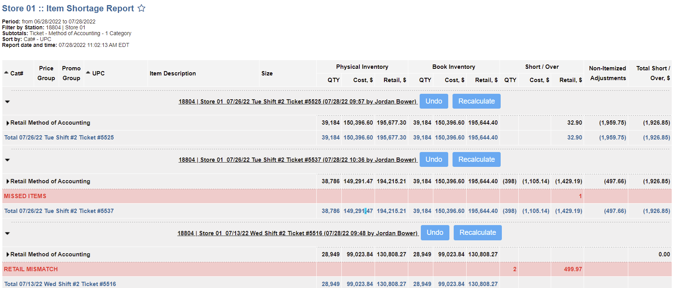
Itemized Inventory – Item Shortage Report
You can perform the following actions with the Item Shortage report:
View the report's data.
Verify inventory results.
Filter and sort the report's data.
Additional actions.

Slide 48
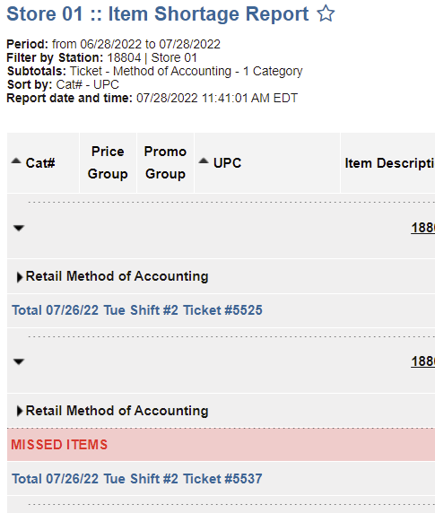
Itemized Inventory – Item Shortage Report
To review more in-depth information, select
Retail Method of Accounting

Slide 49
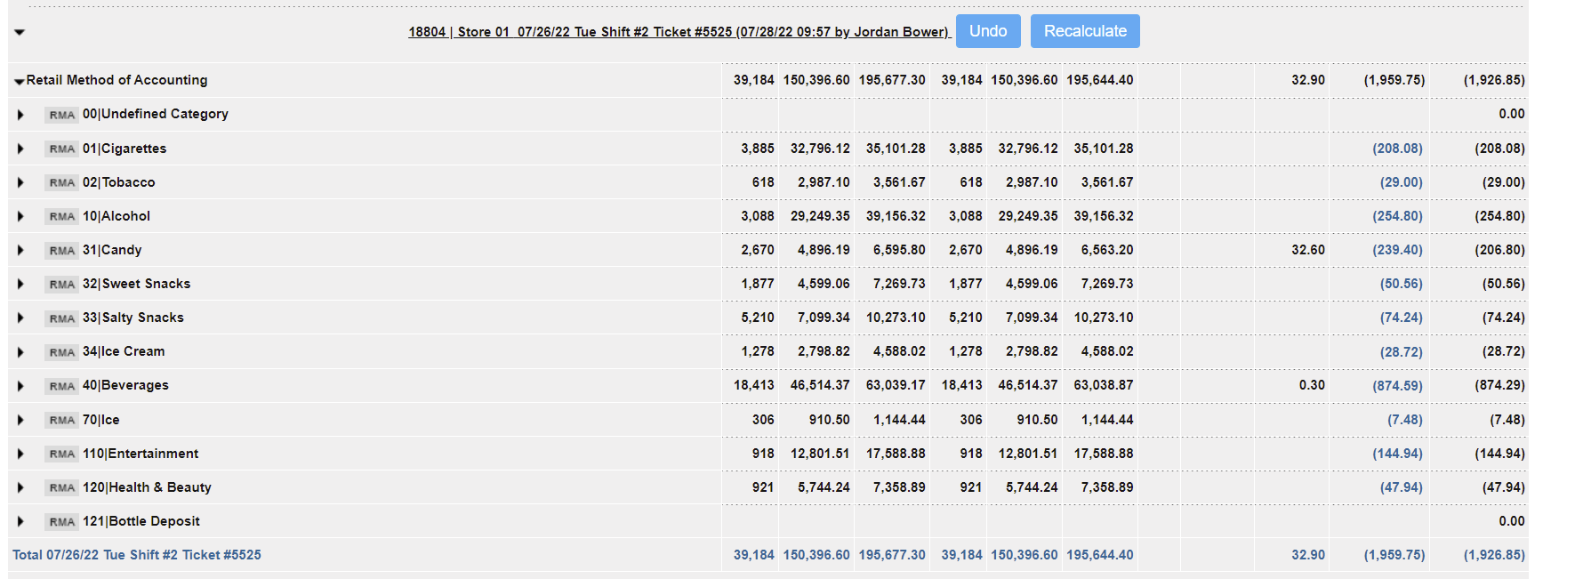
Itemized Inventory – Item Shortage Report
This will display a list of all the categories/departments in the account with further information.
Select each category/department to review itemized level information

Slide 50
Itemized Inventory – Item Shortage Report
While reviewing, if an item has a Retail Short / Over value, ensure account is processing Price Change Tickets. Processing Price Change tickets will accurately keep track of Retail adjustments.

Slide 51
Itemized Inventory – Item Shortage Report
Select the retail value under the Short / Over column for item, to display further information.

Slide 52
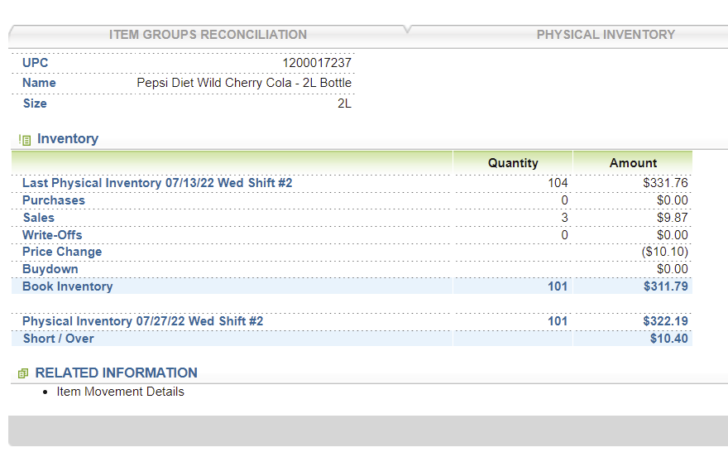
Itemized Inventory – Item Shortage Report
When selected, this will display the items inventory audit information.
Each field can be accessed for more in-depth investigation.

Slide 53
Itemized Inventory – Item Shortage Report
Users can also access the category/department’s Non-Itemized Adjustments by selecting its corresponding retail value.

Slide 54
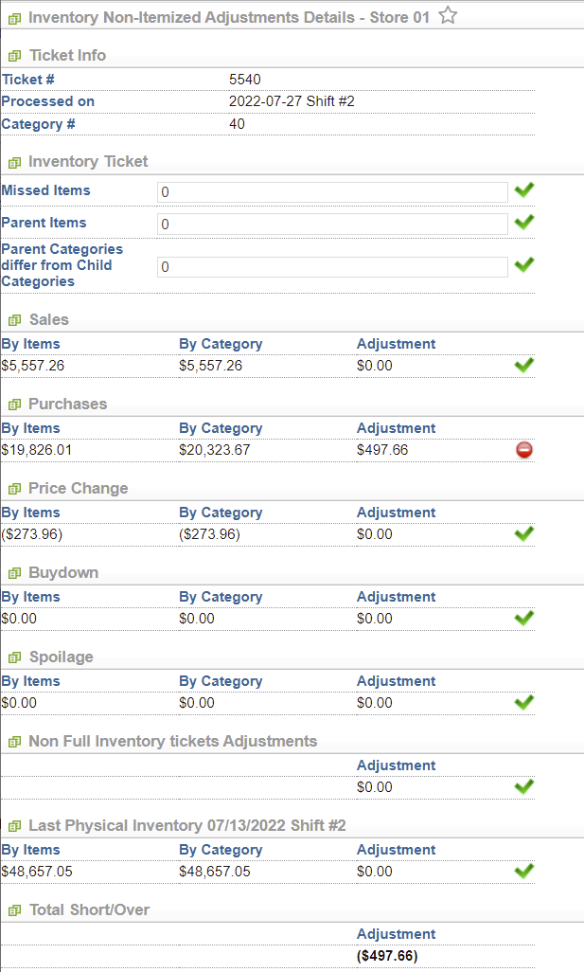
Itemized Inventory – Item Shortage Report
Result:
Users will be displayed the category/departments Non-Itemized Adjustment details report.
Non-itemized adjustments for category/department represent the difference between the inventory short by category and inventory short by items.

Slide 55
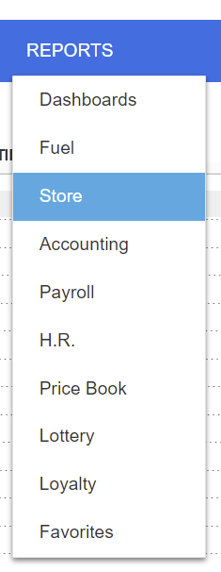
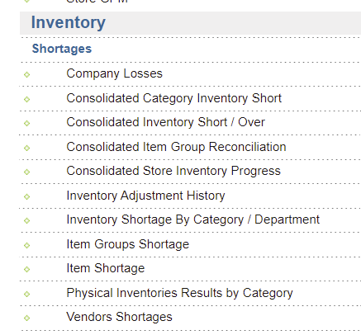
Itemized Inventory – Short / Over Report
The Consolidated Inventory Short / Over report provides an overview of all stores within the account and results from the latest inventories, as well as year-to-date inventory results and shrink percentages.
You can find the report at:
Reports
> Store
Scroll down to the Inventory and Shortages section.
> Consolidated Inventory Short/Over

Slide 56
Itemized Inventory – Short / Over Report
Based on the report data, you can monitor the dates of the last inventory conducted per store within the main account.
The report contains the following information:
Station Name
Last Inventory Date
Last Inventory Results
Short/Over YTD
Short/Over YTD as a Percent of Total Sales
12 Months Short/Over Summary
12 Month Short / Over as a Percent of Total Sales
Inventory Data are Actual On

Slide 57
Category Level Inventory

Slide 58
Category Level Inventory
In the Inventory: Non-Itemized Inventory by Category Values form, you can perform the following actions:
Enter inventory data by categories of items.
View inventory data by categories of items for the selected date.

Slide 59
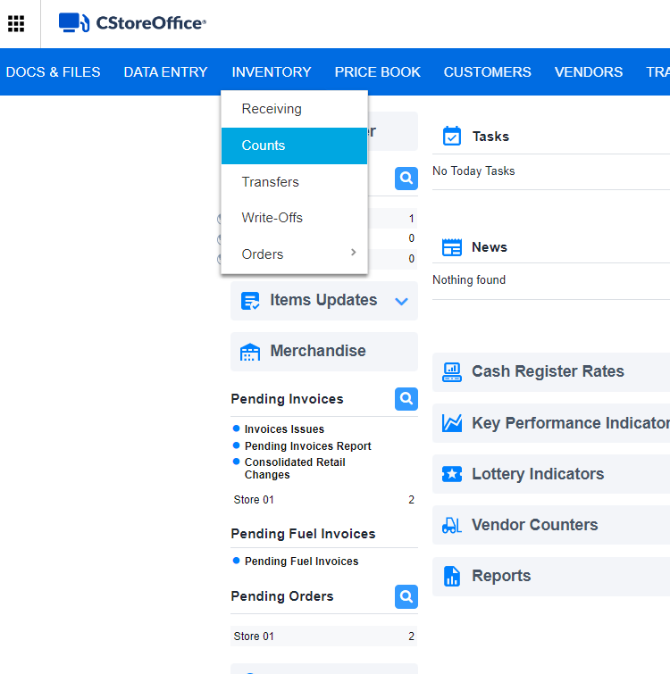
Category Level Inventory
To enter inventory by categories:
From the CStoreOffice® main page, go to:
Inventory
Counts

Slide 60
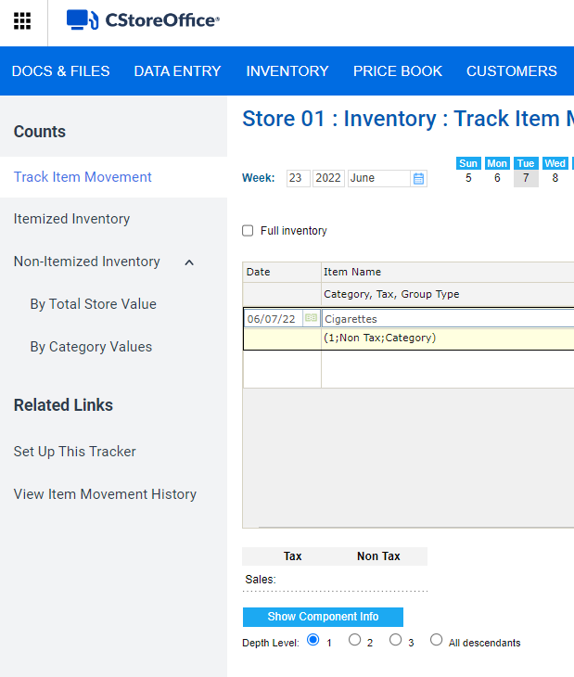
Category Level Inventory
In the left menu, select:
Non-Itemized Inventory
By Category Value

Slide 61
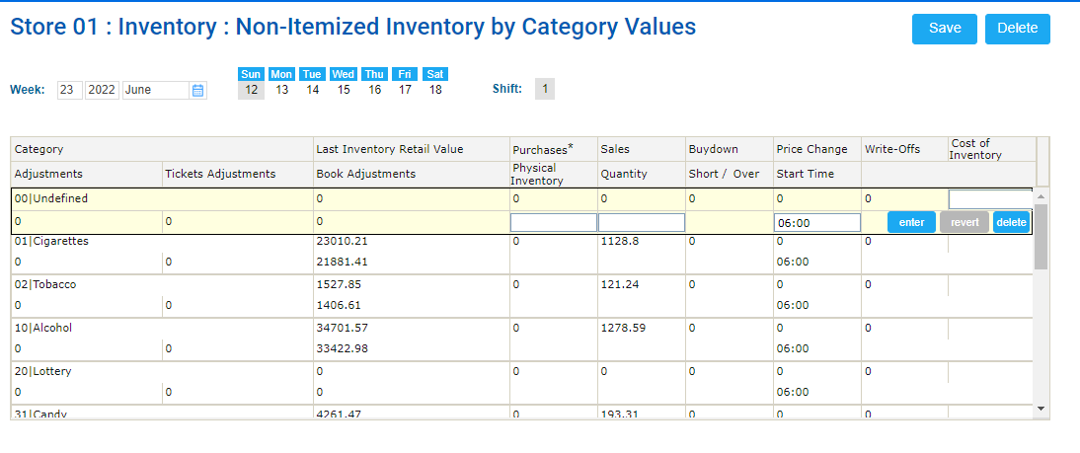
Category Level Inventory
For every category, view the following data:
Category: Category name
Last Inventory Retail Value: Amount of the latest physical inventory by category
Book Adjustments: Adjustments by category
Purchases: Purchases by category
Physical Inventory: The counted inventory by category

Slide 62
Category Level Inventory
Sales: Sales by category
Buydown: Buydown by category
Short/Over: Difference between the Book Inventory and the entered physical inventory
Price Change: Price change by category
Start Time: Inventory start time
Write-offs: Spoilage by category
Tickets adjustments: Adjustments by tickets by category
Cost of Inventory: Inventory by category counted by the server

Slide 63
Category Level Inventory
For every category, view and enter the following data:
Physical Inventory: The counted inventory by category
Quantity: Quantity by category
To the right of the row, click enter.
Once all categories are entered, at the top right of the form, click Save.

Slide 64
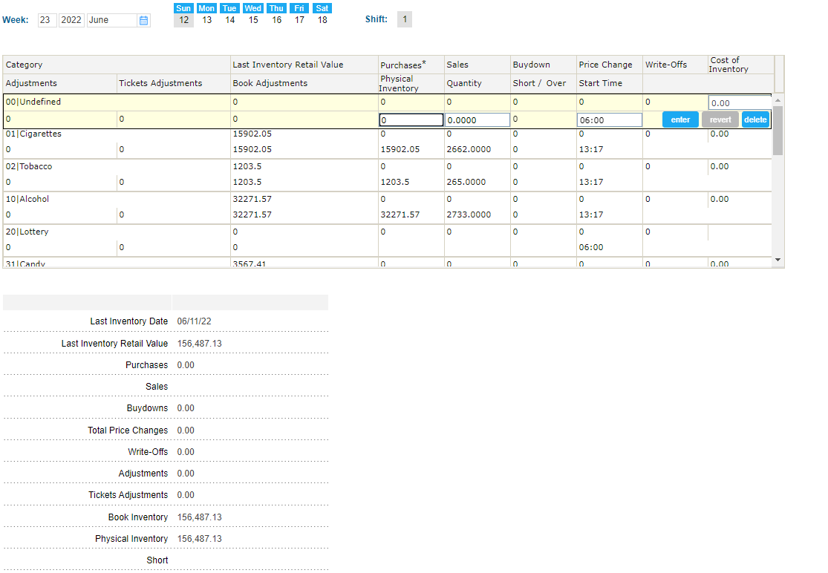
Category Level Inventory
Result: The summary data will be displayed at the bottom of the form.

Slide 65
THANK YOU!
Notes:
Say: Thank you for your time. Does anyone have any questions?
Do: Respond to questions.
Do: <End Meeting>

